Slide 1
EGB1201 – JAVA PROGRAMMING
PROJECT REVIEW-2
3
Department of Electrical and Electronics Engineering
Academic Year: 2025 – 2026 (Odd Semester)
Register Number :927624BEE017
Name :DHANIKESH S
Year :II
Semester :III
Section :EEE-A
Date :21.11.2025

Slide 2
Title of the Project
Banking ATM with PIN security

Slide 3
Abstract
The Banking ATM with PIN Security project simulates the working of an Automated Teller Machine (ATM) with secure access using a Personal Identification Number (PIN).
The system ensures that only authorized users can perform banking operations such as balance inquiry, cash withdrawal, deposit, and exit.
The PIN verification mechanism enhances security by allowing a maximum of three attempts, after which the card is blocked to prevent unauthorized access.
This project is implemented in Java, making use of conditional statements, loops, and user input handling for efficient execution.
The model demonstrates the integration of basic banking operations with authentication, which is the core principle behind real-world ATM systems.

Slide 4
Abstract with CO/PO Mapping
Abstract | CO | POs | PSO
The Banking ATM with PIN Security project simulates the working of an Automated Teller Machine (ATM) with secure access using a Personal Identification Number (PIN).The system ensures that only authorized users can perform banking operations such as balance inquiry, cash withdrawal, deposit, and exit.The PIN verification mechanism enhances security by allowing a maximum of three attempts, after which the card is blocked to prevent unauthorized access.This project is implemented in Java, making use of conditional statements, loops, and user input handling for efficient execution.The model demonstrates the integration of basic banking operations with authentication, which is the core principle behind real-world ATM systems. | CO1 CO2 CO3 CO4 | PO1 PO2 PO3 PO4 PO5 PO6 PO7 PO8 PO9 PO10 PO11 PO12

Slide 5
Introduction
The Banking ATM with PIN Security system is a simple simulation of real-world Automated Teller Machines, designed to provide secure and convenient banking services to customers.
An ATM allows users to perform essential transactions such as checking account balance, withdrawing cash, and depositing money without visiting a bank branch.
To ensure security, the system uses a Personal Identification Number (PIN) that must be correctly entered before accessing any service.
If the PIN entered is incorrect more than three times, the account is temporarily blocked to prevent unauthorized access.
This project, implemented in Java, demonstrates the integration of user authentication with basic banking operations, highlighting how ATM systems maintain both security and user convenience.

Slide 6
Java Programming - Concepts Used
Conditional Statements (if, else if, switch):
Used for decision-making during PIN verification and transaction selection.
Loops (while, for):
Used to repeat PIN attempts and allow continuous banking operations until exit.
Classes and Objects:
The project follows Object-Oriented Programming (OOP) principles — ATM, UserAccount, and Main classes handle modular functionality.
Methods (Functions):
Functions such as checkBalance(), deposit(), withdraw() make the code reusable and organized.
Exception Handling (try–catch):
Prevents the program from crashing during invalid inputs or withdrawal errors.
Scanner Class (Input Handling):
Used to get user input for PIN and transaction choices securely.

Slide 7
Proposed Architecture
The proposed architecture of the Banking ATM with PIN Security system is designed with three main layers the user interface layer, which allows customers to interact with the system by entering their PIN and selecting services
The authentication layer, which verifies the entered PIN and restricts access after three failed attempts to ensure security and the transaction processing layer, which handles core banking functions such as balance inquiry, cash withdrawal, and deposit.
This architecture provides a secure, efficient, and user-friendly way to simulate ATM operations using Java programming.

Slide 8
Proposed Architecture - Description
The proposed architecture of the Banking ATM with PIN Security system is designed with three main layers the user interface layer, which allows customers to interact with the system by entering their PIN and selecting services
The authentication layer, which verifies the entered PIN and restricts access after three failed attempts to ensure security and the transaction processing layer, which handles core banking functions such as balance inquiry, cash withdrawal, and deposit.
This architecture provides a secure, efficient, and user-friendly way to simulate ATM operations using Java programming.

Slide 9
Proposed Architecture - Description (Cont..)
The Banking ATM with PIN Security project is structured into three major layers:
User Interface Layer
  Handles user interactions through the console.
  Displays transaction options and collects user inputs.
  Uses the Scanner class for input.
Authentication Layer
  Verifies the entered PIN with stored PIN data.
  Allows a maximum of 3 attempts.
  If the PIN fails three times, access is blocked using conditional logic.

Slide 10
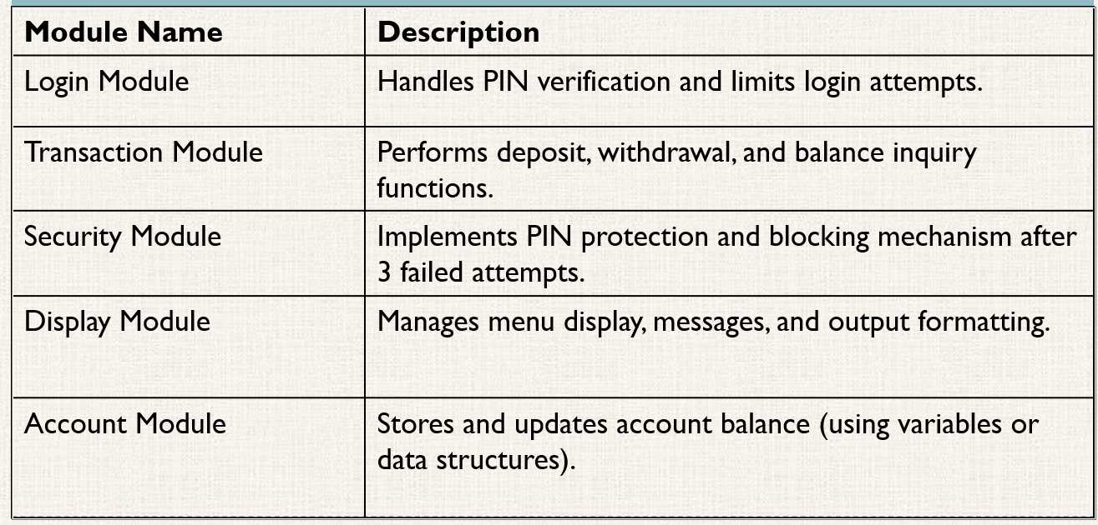
List of Modules

Slide 11
Module Description
Login Module :
Verifies user PIN and limits attempts to three.
Transaction Module :
Handles deposit, withdrawal, balance inquiry, and exit.
Security Module :
Ensures safe access and blocks after failed attempts.
Display Module :
Shows menus, messages, and transaction results.
Account Module :
Maintains and updates user account balance.

Slide 12
Module Description (Cont..)
Input Handling Module :
Uses Scanner class to read user input safely.
Validation Module :
Checks for invalid entries or insufficient balance.
Utility Module :
Supports reusable functions for calculations and updates.
Exit Module :
Allows the user to securely end the session and display a thank-you message.

Slide 13
Results and Discussion
The system successfully simulates an ATM environment using Java.
Users can authenticate with a PIN and perform operations like deposit, withdrawal, and balance inquiry.
The security feature effectively blocks access after three failed PIN attempts.
The program demonstrates efficient use of Java concepts such as loops, conditionals, and exception handling.
Results show accurate balance updates and smooth user interaction.
The system provides a simple, secure, and user-friendly interface for banking simulations.

Slide 14
Results and Discussion (Cont..)
The project ensures data security through PIN-based authentication.
Error handling prevents crashes during invalid inputs or withdrawals.
The architecture proves modular and extendable for future upgrades.
Demonstrates real-world ATM logic effectively in a Java console program.
Enhances understanding of OOP concepts and user interaction in Java.

Slide 15
Conclusion
The project successfully simulates an ATM system with secure PIN authentication.
It demonstrates the practical use of Java programming concepts such as loops,
conditionals, and classes.Ensures security and accuracy in banking operations like
deposit, withdrawal, and balance inquiry.Provides a user-friendly and efficient
interface for performing transactions.Can be further enhanced with database
connectivity and GUI integration in future versions.

Slide 16
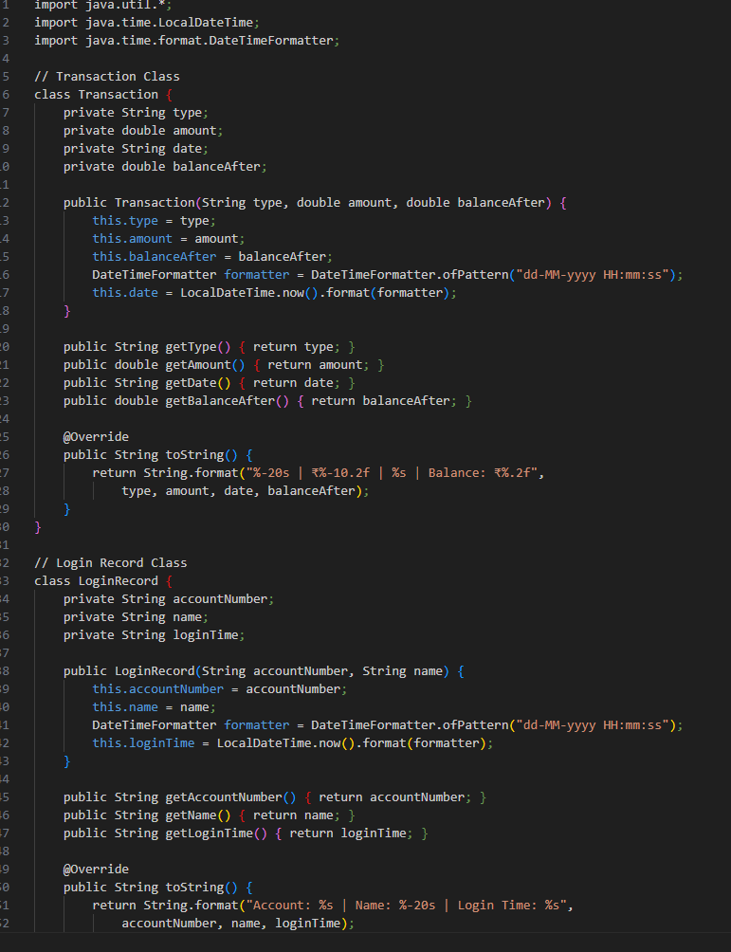
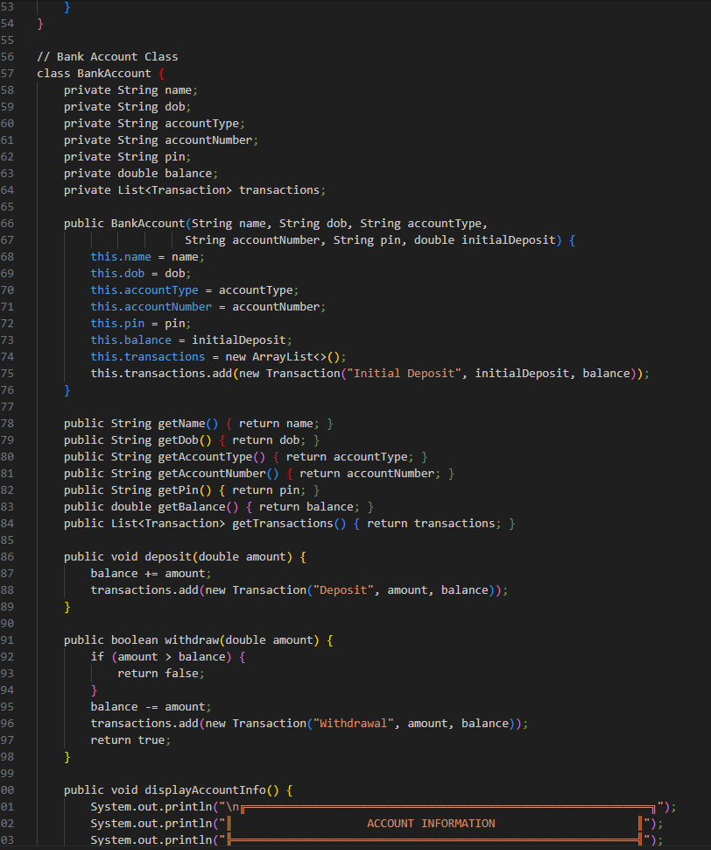
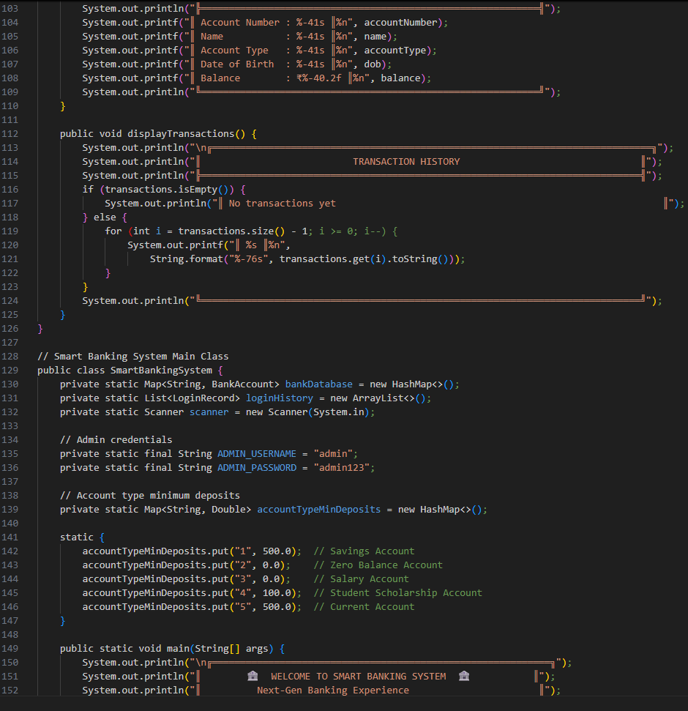
CODING

Slide 17
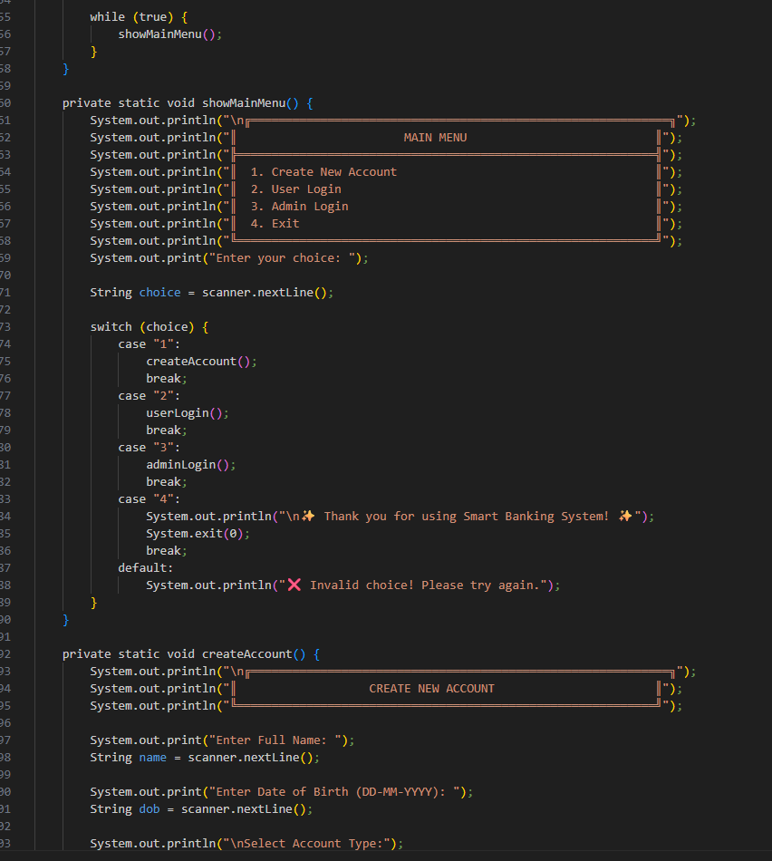
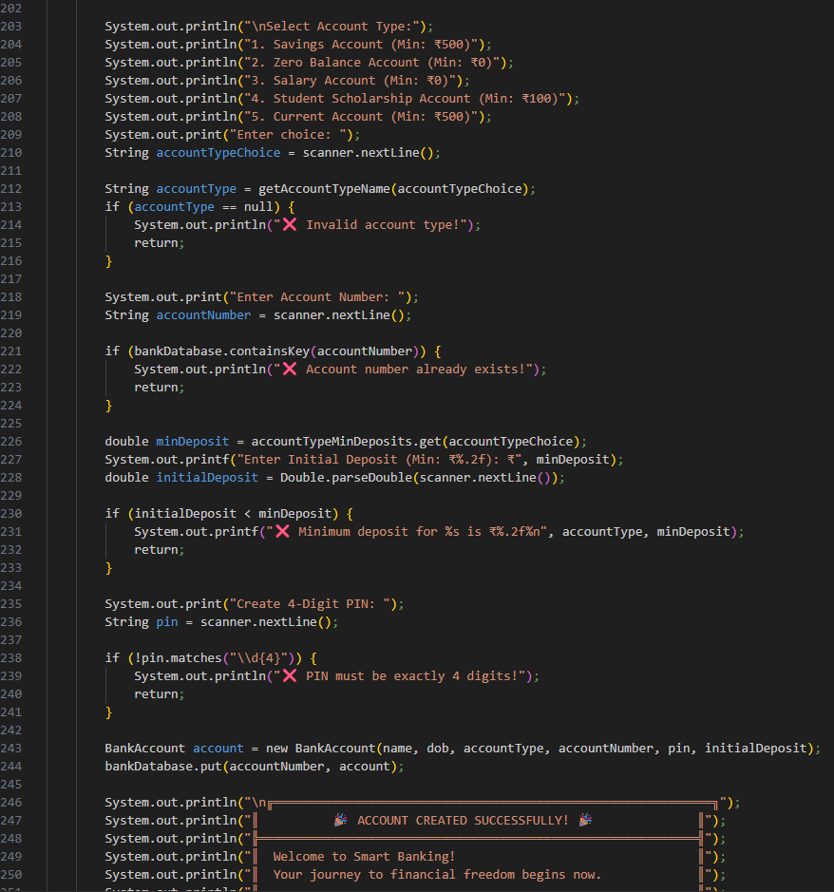
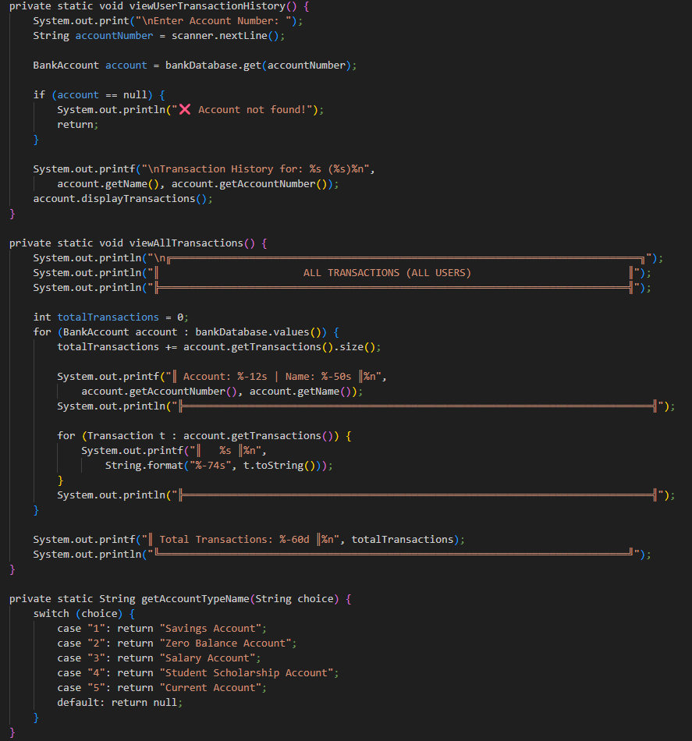
CODING

Slide 18
Thank You
Any queries???

